Slide 1

Heath Insurance Analysis EXCEL Project

Slide 2


Project analysis slide 2
Project Analysis
ANALYSIS
SPECIFICATION
PROJECT
CREATE DASHBOARD
GET DATA
(From Kaggle in csv format)
CREATE CHARTS & TABLES
MANIPULATE DATA

Slide 3
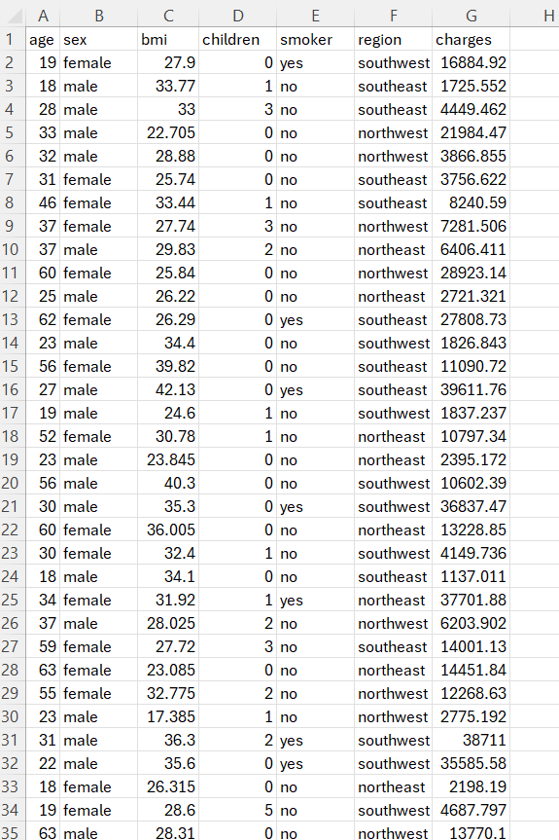
Get Data

Slide 4
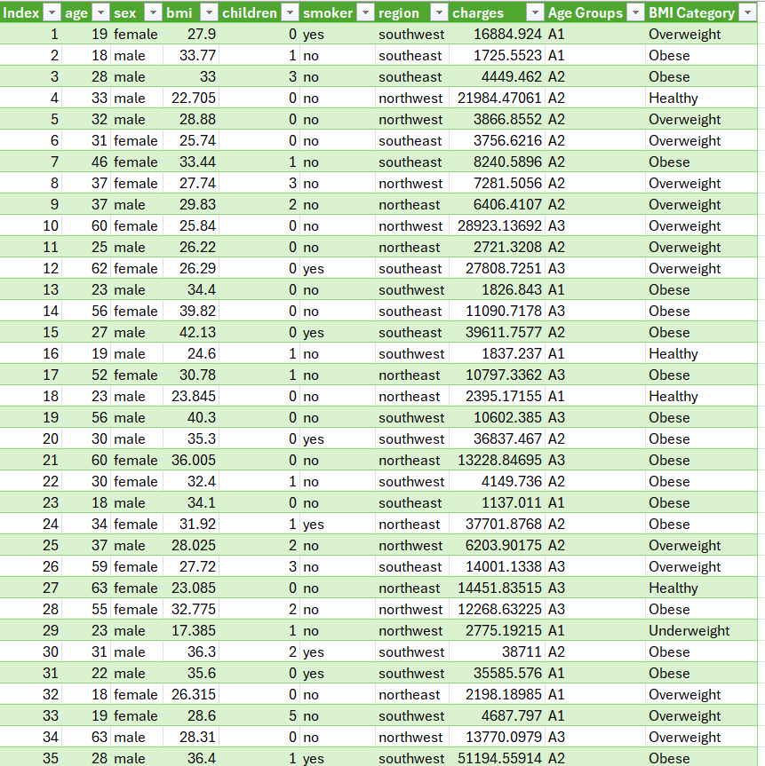
Manipulate Data

Slide 5
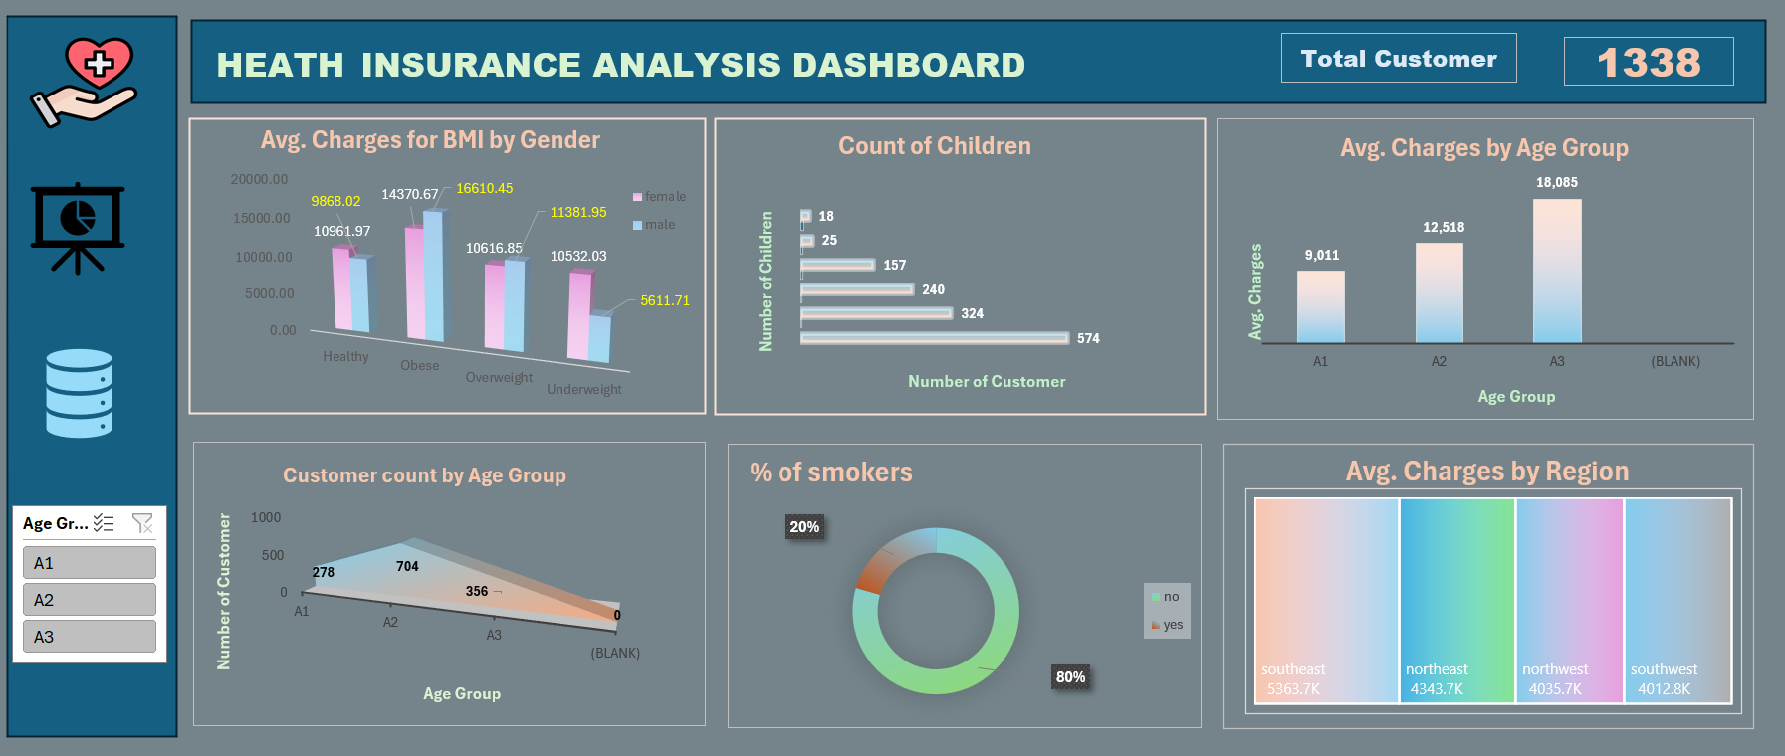
DASHBOARD

Slide 6
Thank You
Any Questions OR Any Advices

